Slide 1
What will be on the exam

Slide 2
This powerpoint is designed to be a “Living Document” to help guide your revision and prioritise the learning you need to do.
While we cannot know what will be on the external exam in 2024, we can use the past to guide us.
This powerpoint now belongs to you and you should edit, colour, comment and scribble as you helps you.
All questions and their solutions can be most easily found by visiting Exam Insights | Smarter QCAA Exam Preparation (exam-insights.com)

Slide 3
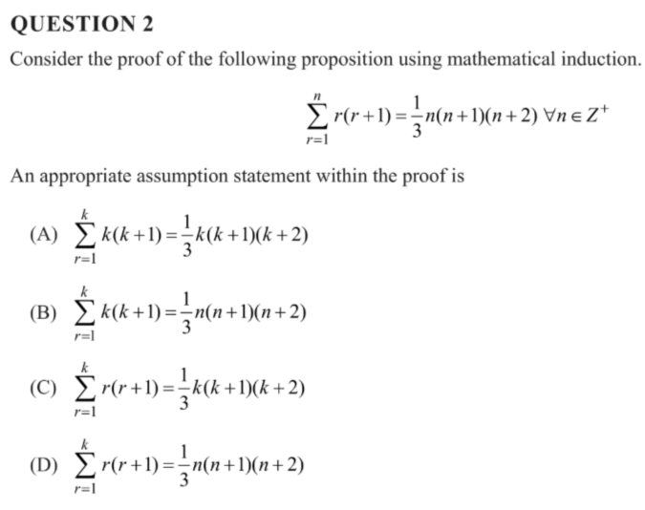
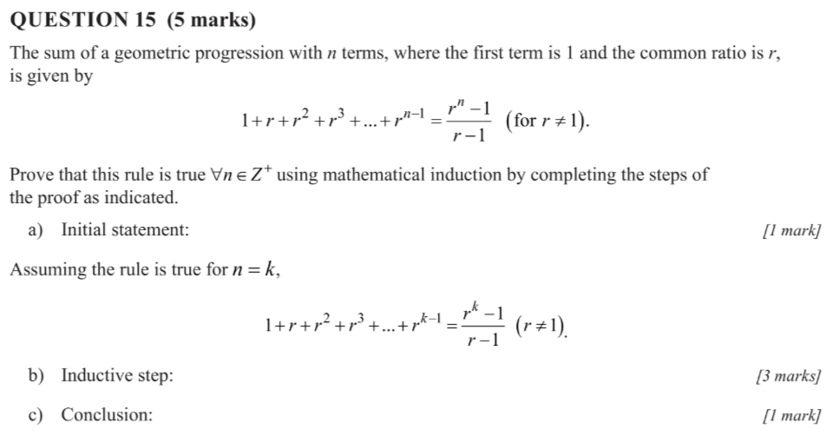
Proof by mathematical Induction
kwajdfhakjf
2023

Slide 4
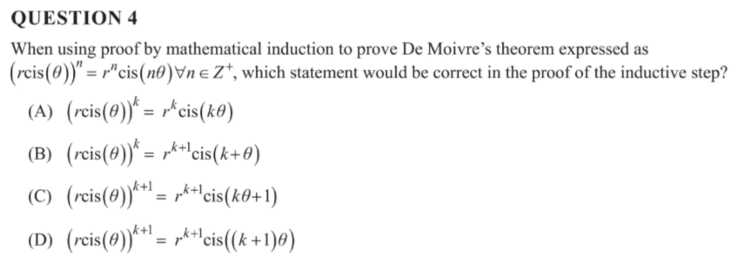
Proof by mathematical Induction
2022

Slide 5
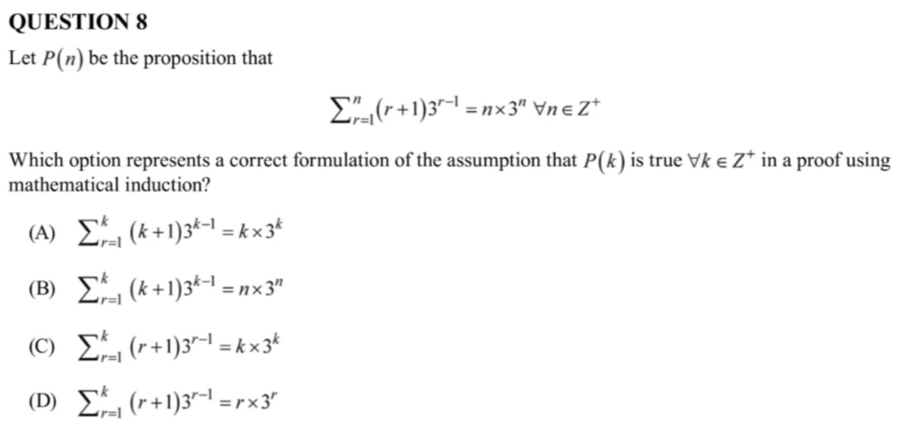
Proof by mathematical Induction
2021

Slide 6
Proof by mathematical Induction
2020

Slide 7
Proof by induction
What are you confident with?
What aren’t you confident with?
How can you address that?
How much study time should you devote to this?

Slide 8
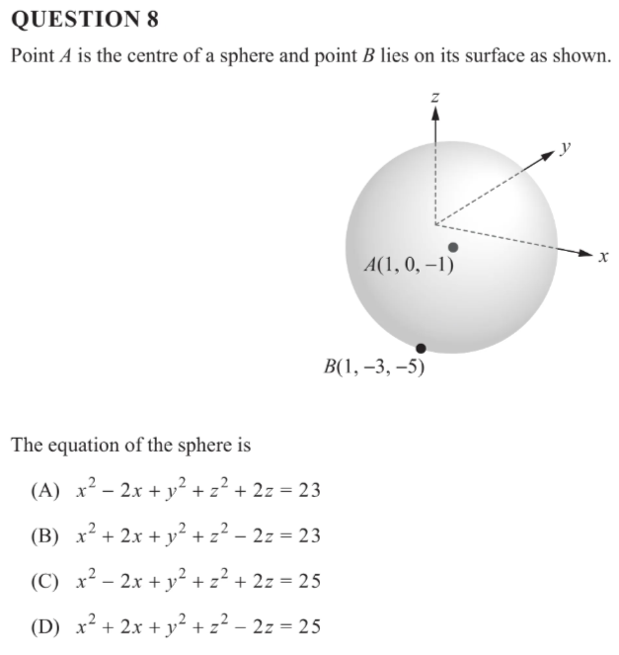
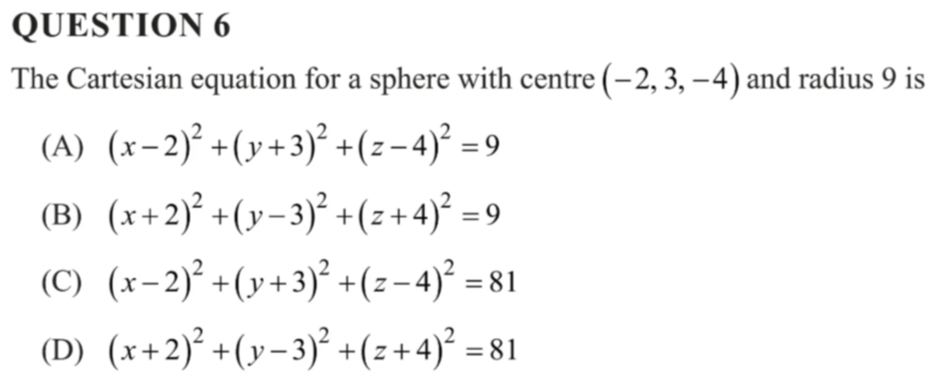
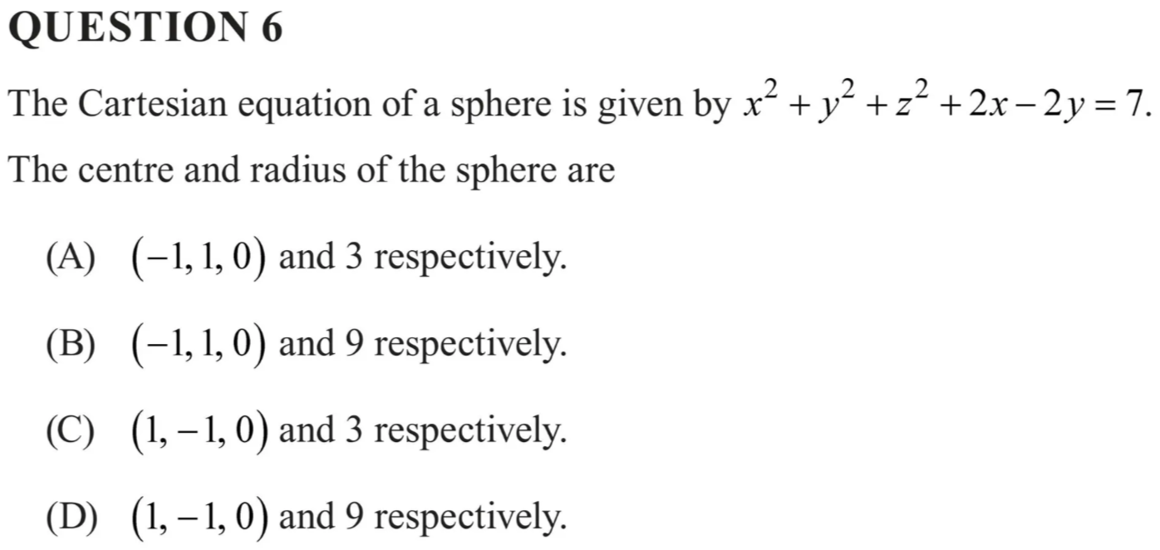
Spheres
2023
2022
2021

Slide 9
Spheres
What are you confident with?
What aren’t you confident with?
How can you address that?
How much study time should you devote to this?

Slide 10
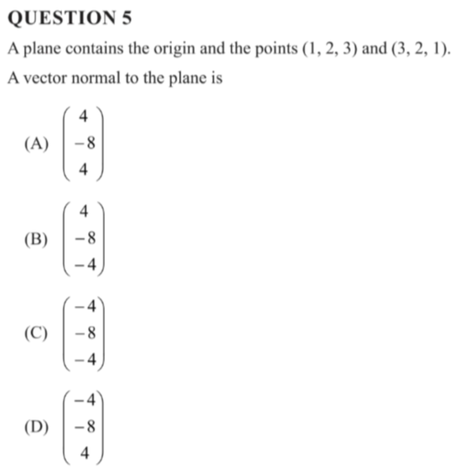
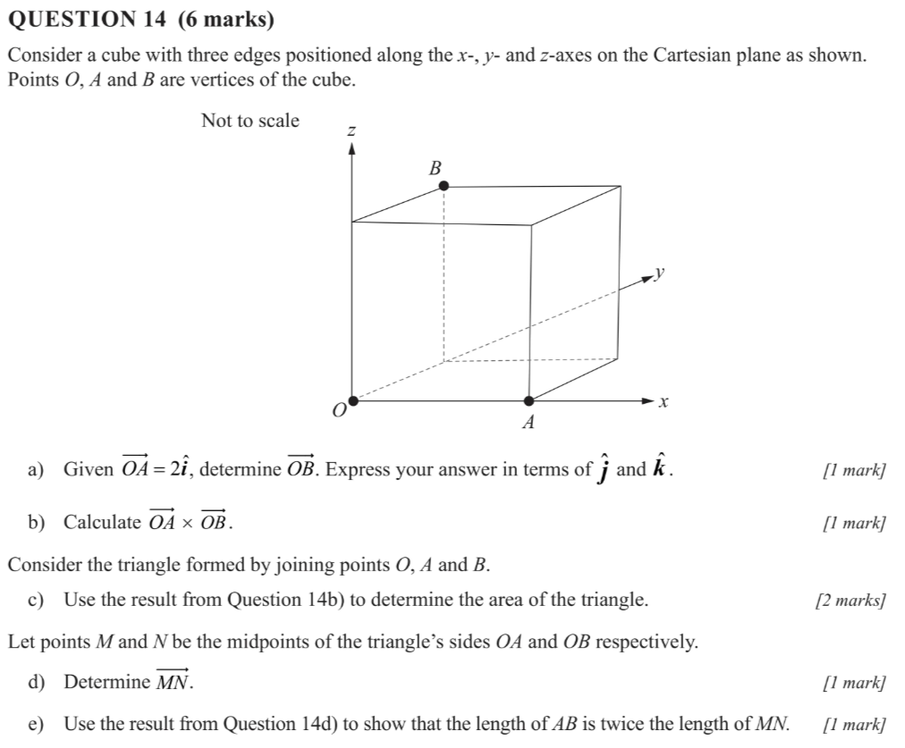
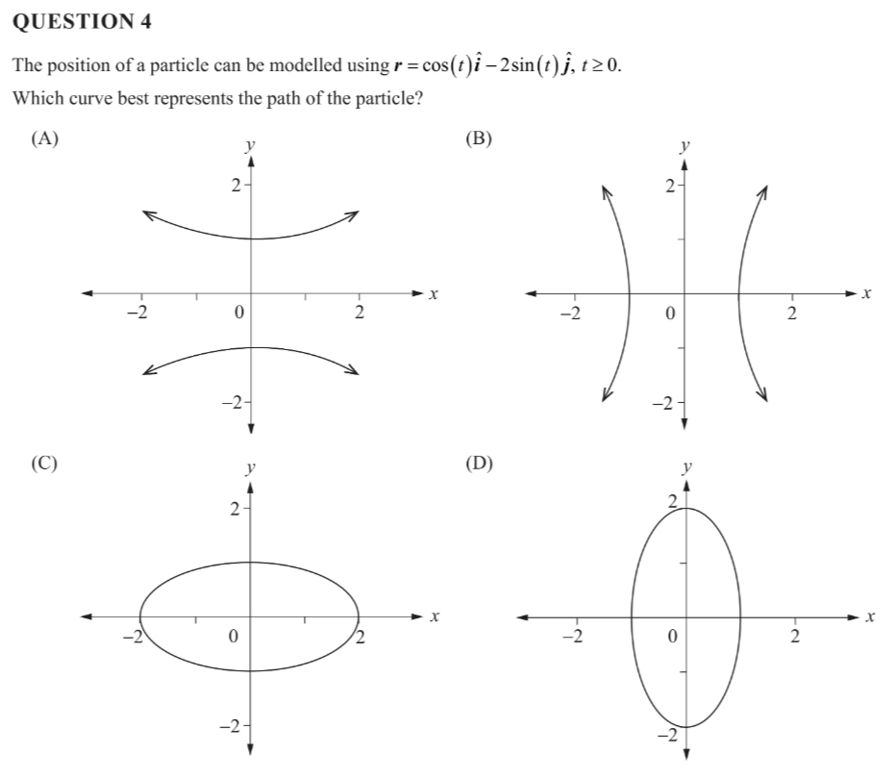
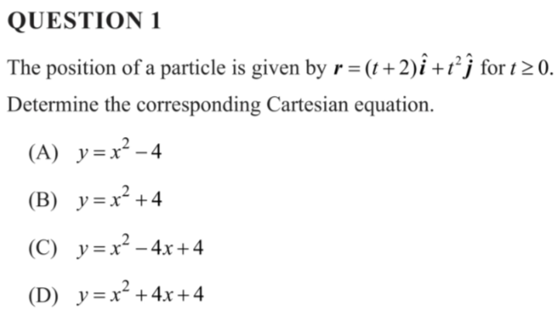
Vectors in 3D & Planes
2023

Slide 11
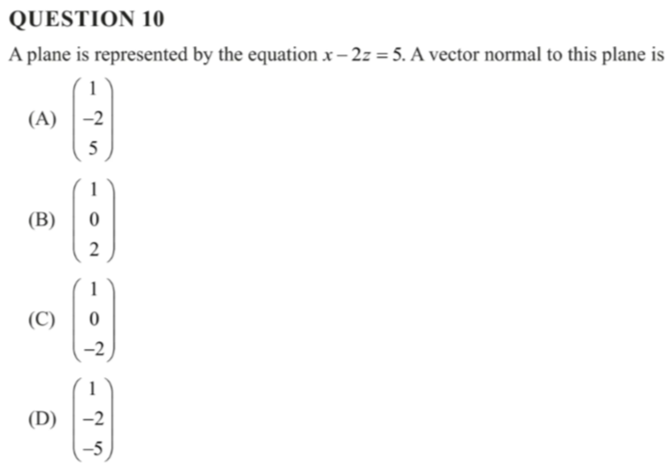
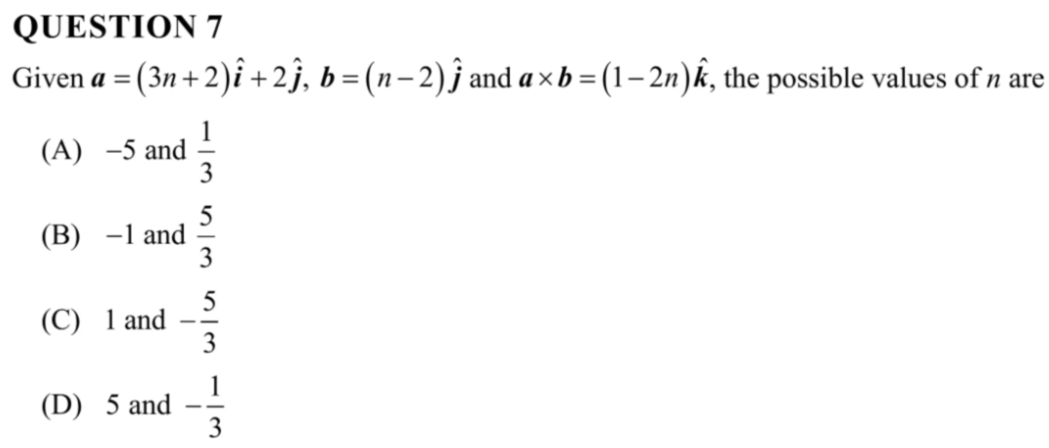
Vectors in 3D & Planes
2022

Slide 12
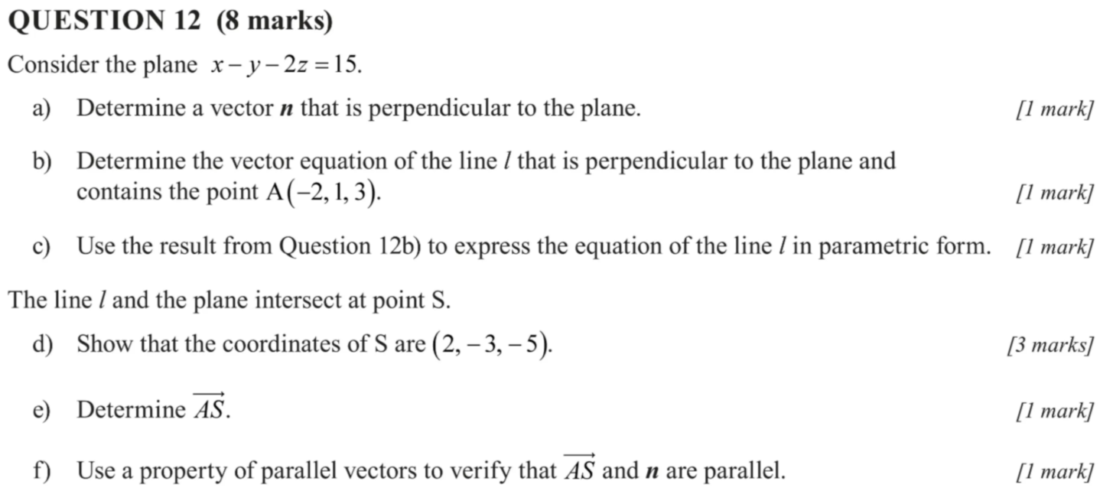
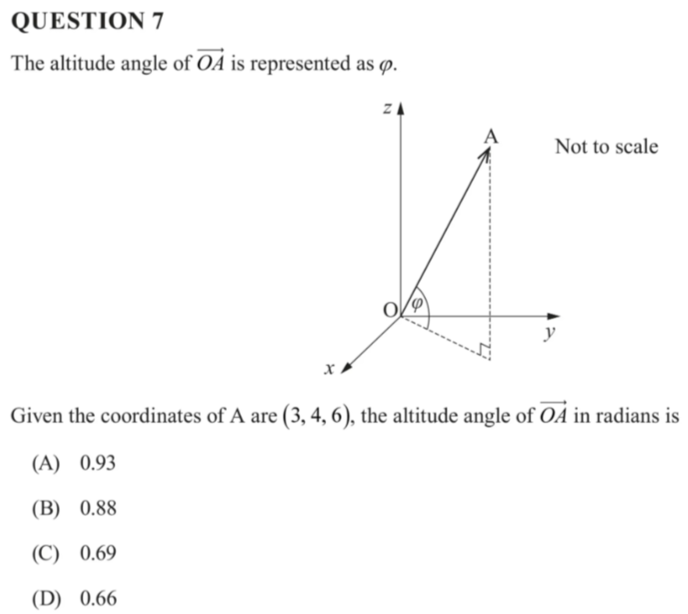
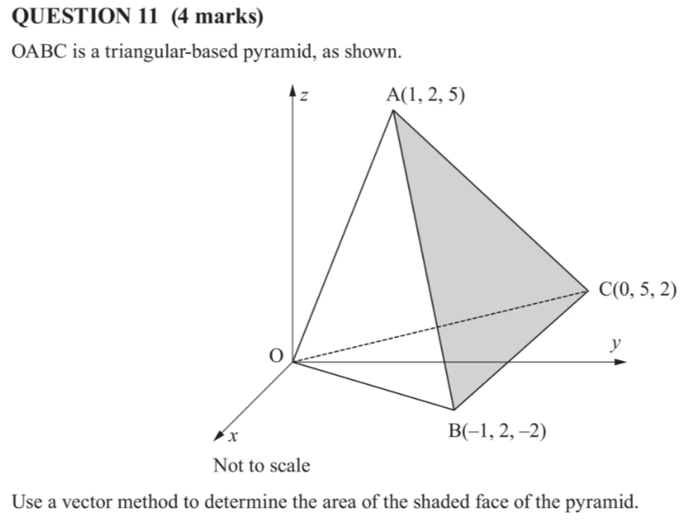
Vectors in 3D & Planes
2021

Slide 13
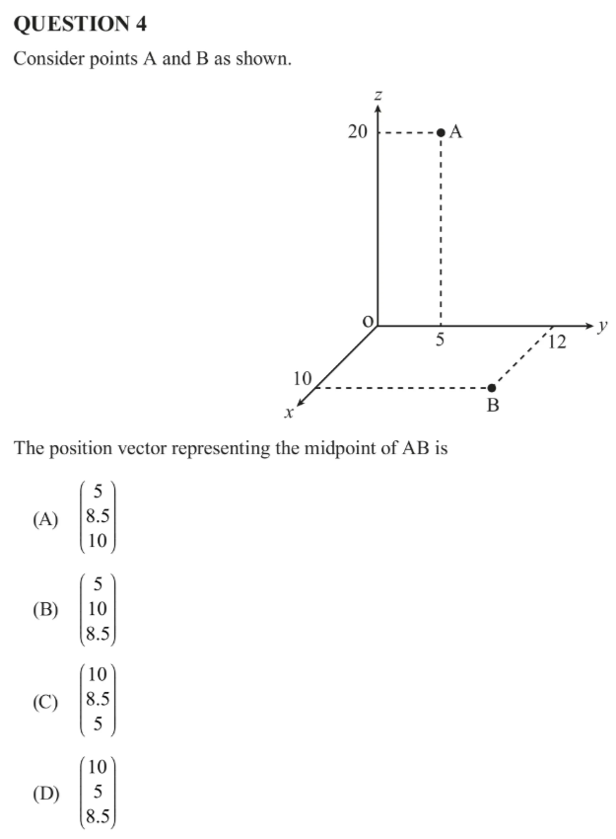
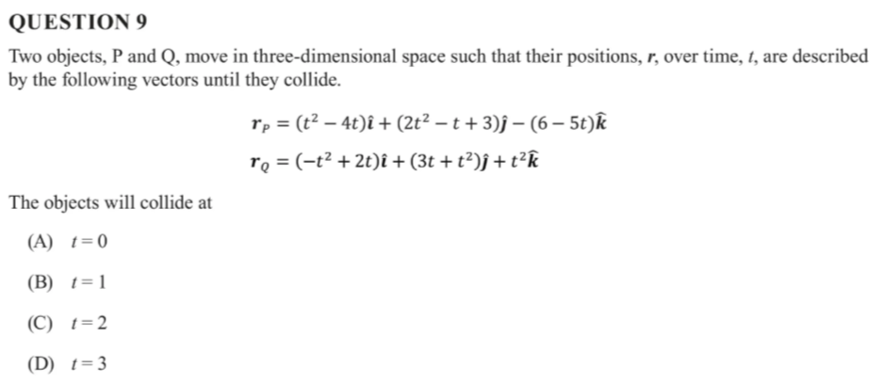
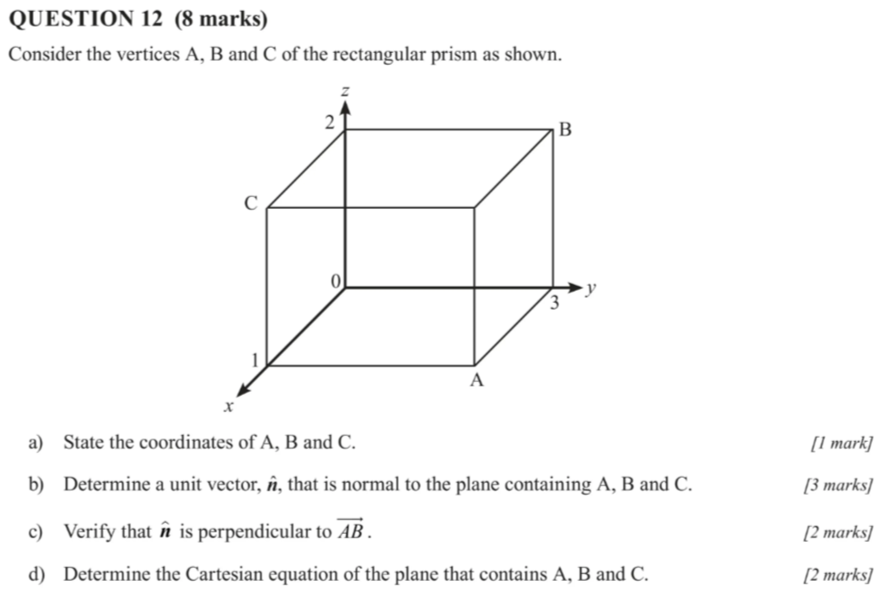
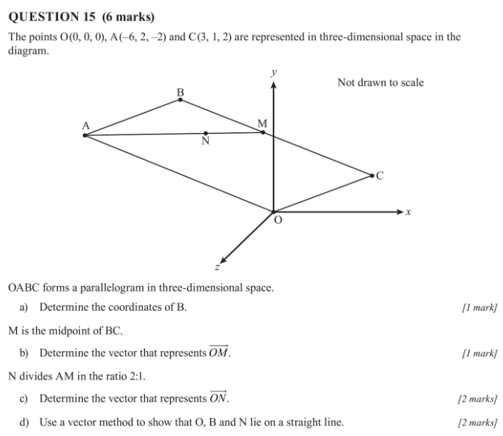
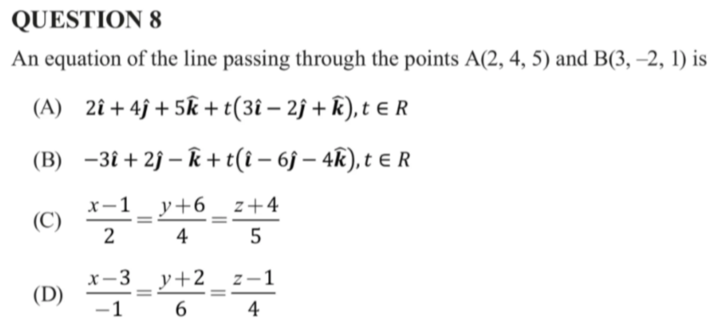
Vectors in 3D & Planes
2020

Slide 14
Vectors in 3D & Planes
What are you confident with?
What aren’t you confident with?
How can you address that?
How much study time should you devote to this?

Slide 15
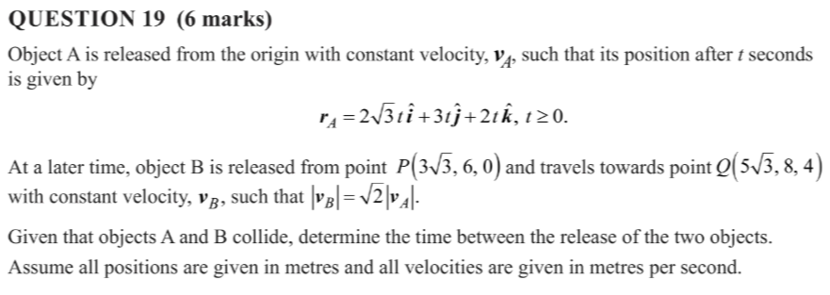
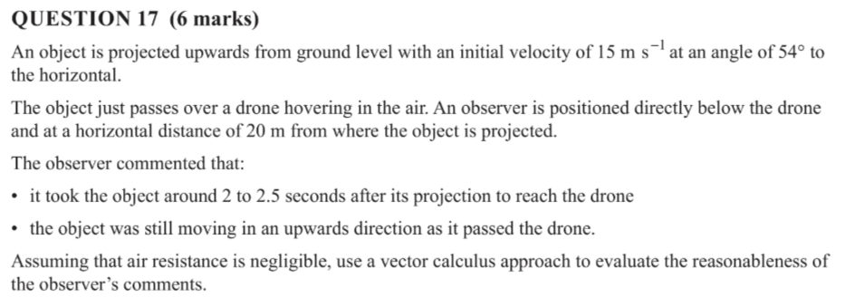
Vectors Calculus
2023

Slide 16
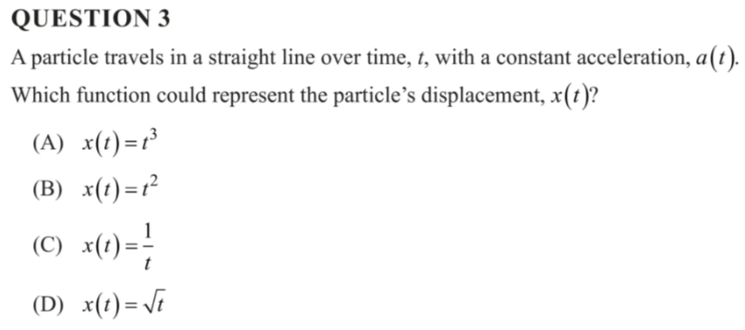
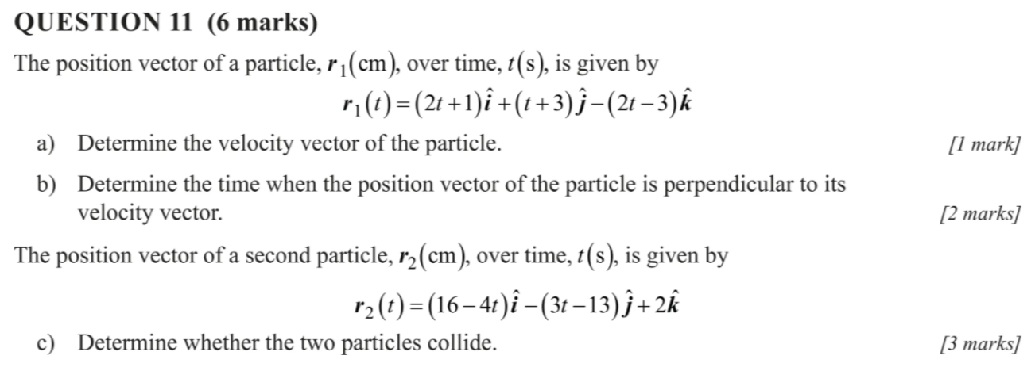
Vectors Calculus
2022

Slide 17
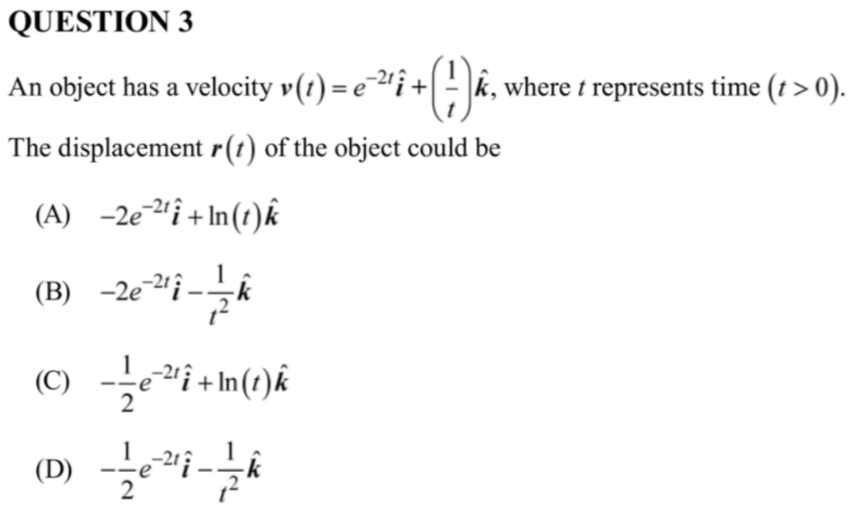
Vectors Calculus
2021

Slide 18
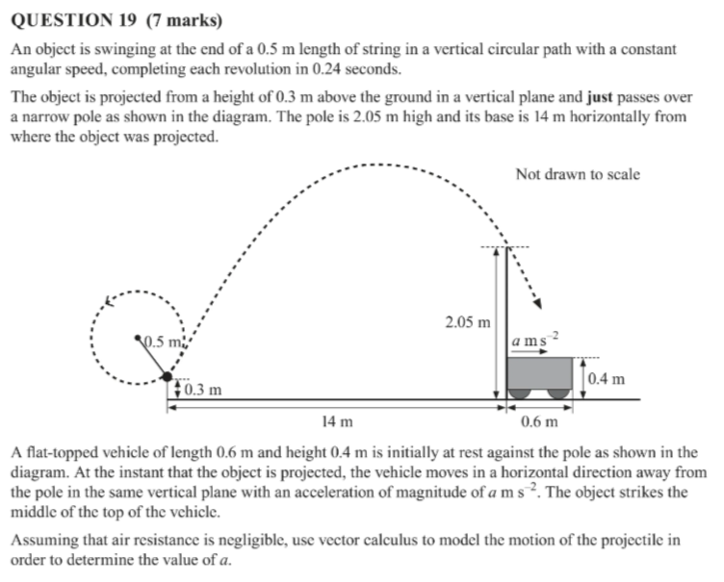
Vectors Calculus
2020

Slide 19
Vectors calculus
What are you confident with?
What aren’t you confident with?
How can you address that?
How much study time should you devote to this?

Slide 20
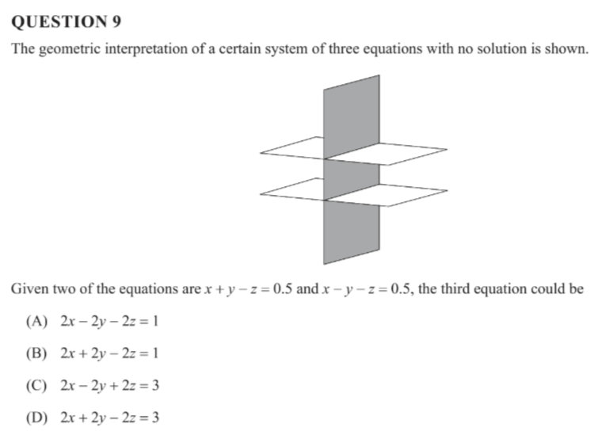
Matrix Algebra and Gaussian Elimination
2023

Slide 21
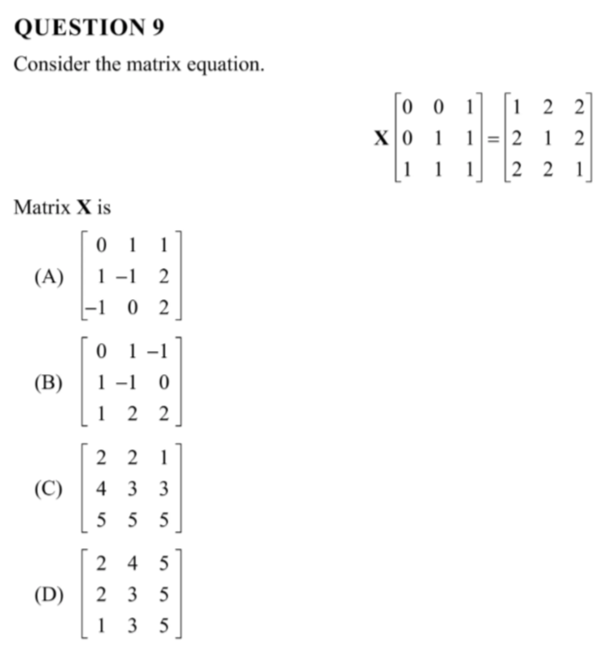
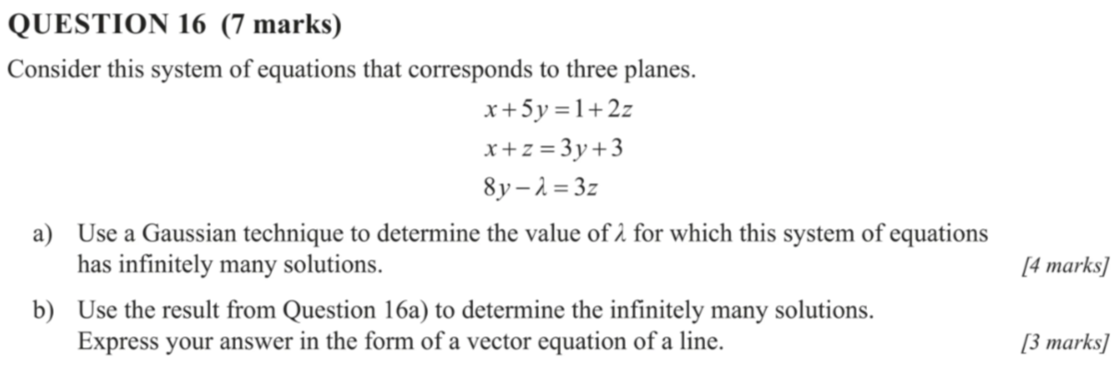
Matrix Algebra and Gaussian Elimination
2022

Slide 22
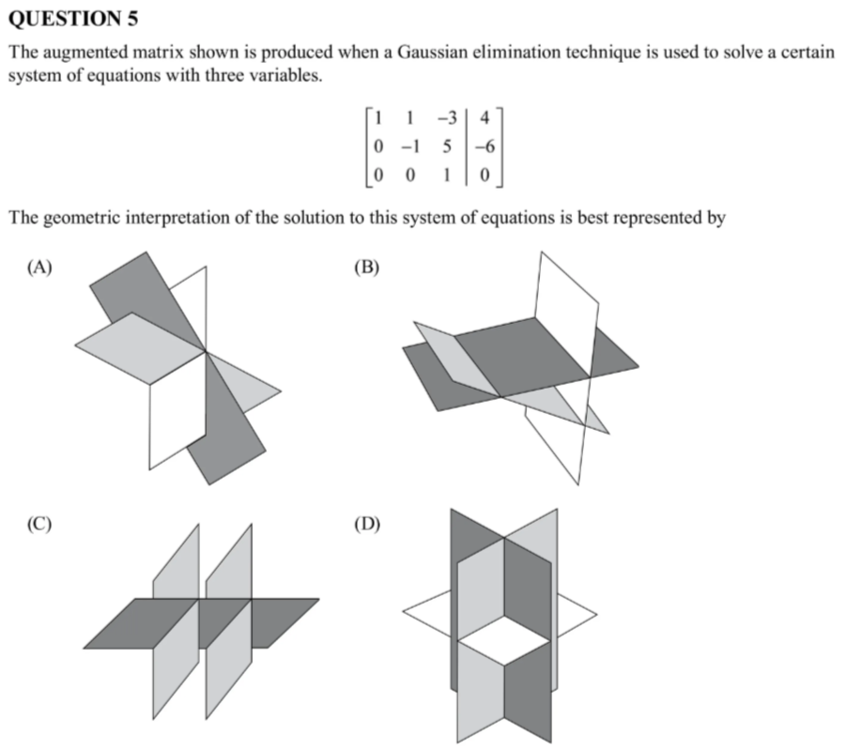
Matrix Algebra and Gaussian Elimination
2021

Slide 23
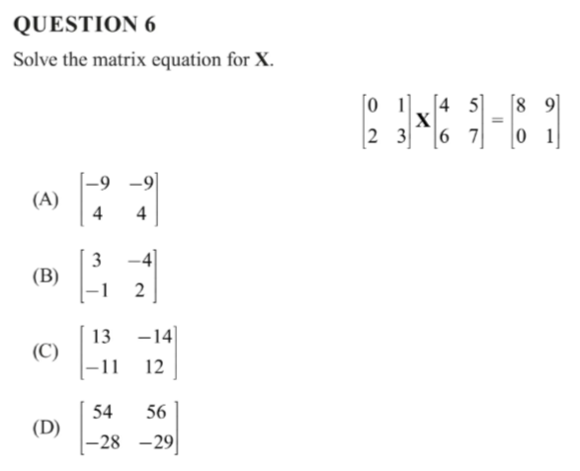
Matrix Algebra and Gaussian Elimination
2020

Slide 24
Matrix Algebra and Gaussian Elimination
What are you confident with?
What aren’t you confident with?
How can you address that?
How much study time should you devote to this?

Slide 25
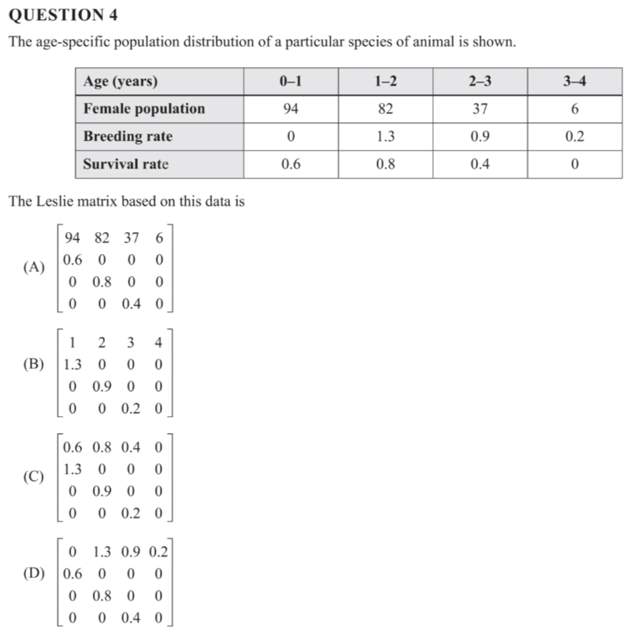
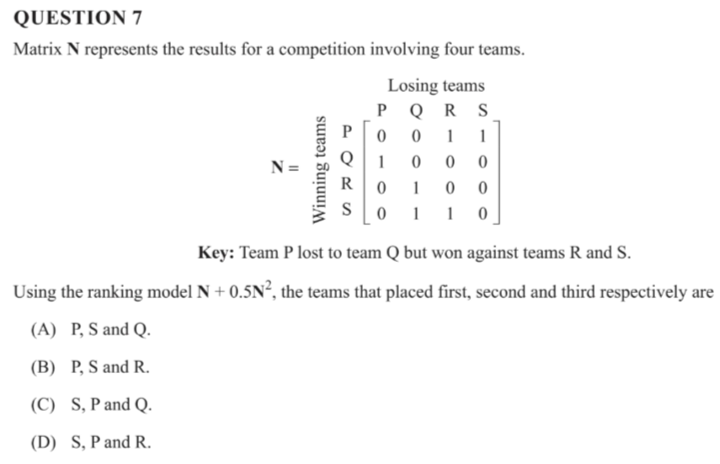
Leslie & Dominance matrices
2023

Slide 26
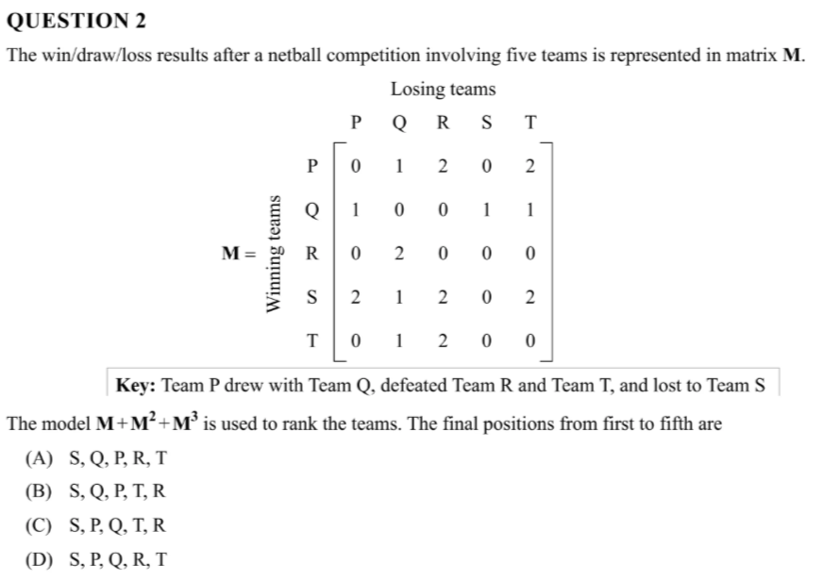
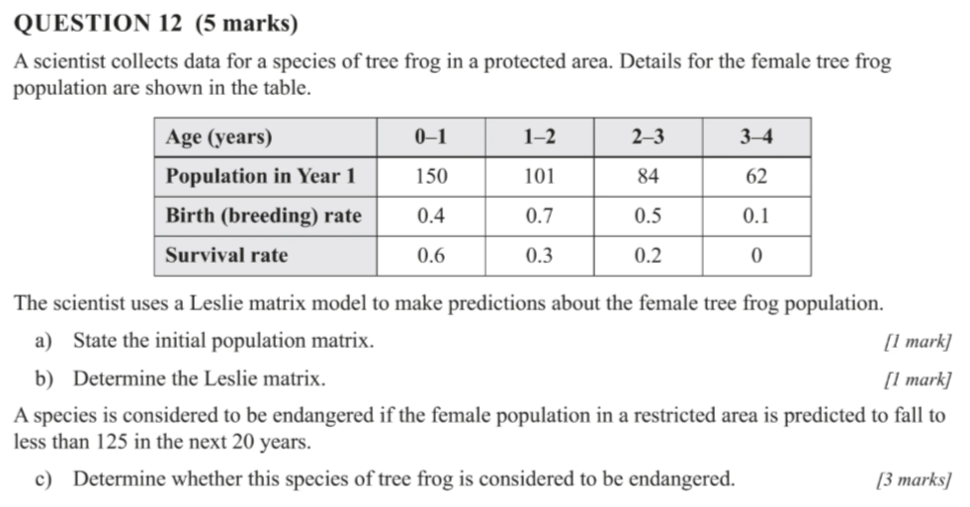
Leslie & Dominance matrices
2022

Slide 27
Leslie & Dominance matrices
2021

Slide 28
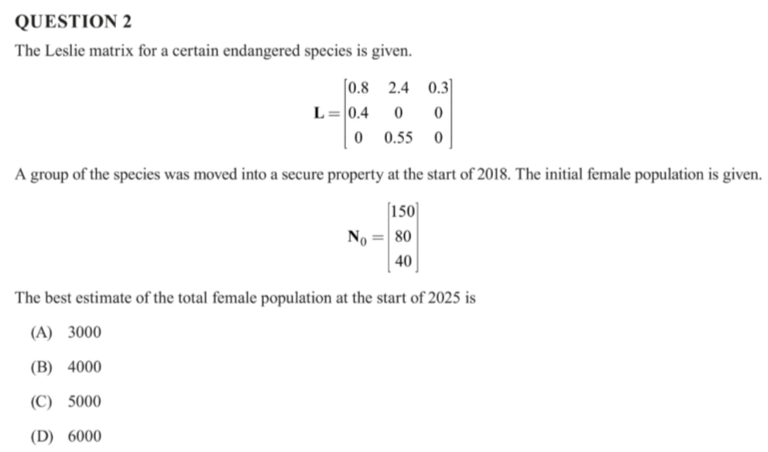
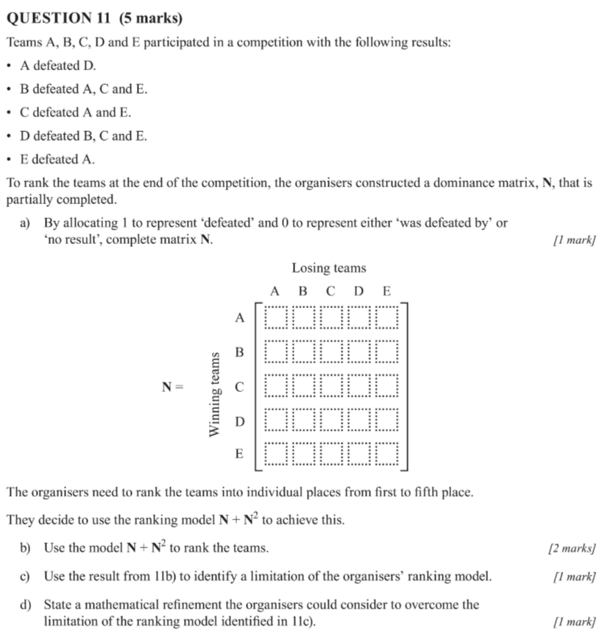
Leslie & Dominance matrices
2020

Slide 29
Leslie & Dominance Matrices
What are you confident with?
What aren’t you confident with?
How can you address that?
How much study time should you devote to this?

Slide 30
Complex Numbers (The Unfamiliar)
2023
2022
2021
2020

Slide 31
Complex Numbers (The Unfamiliar)
What are you confident with?
What aren’t you confident with?
How can you address that?
How much study time should you devote to this?

Slide 32
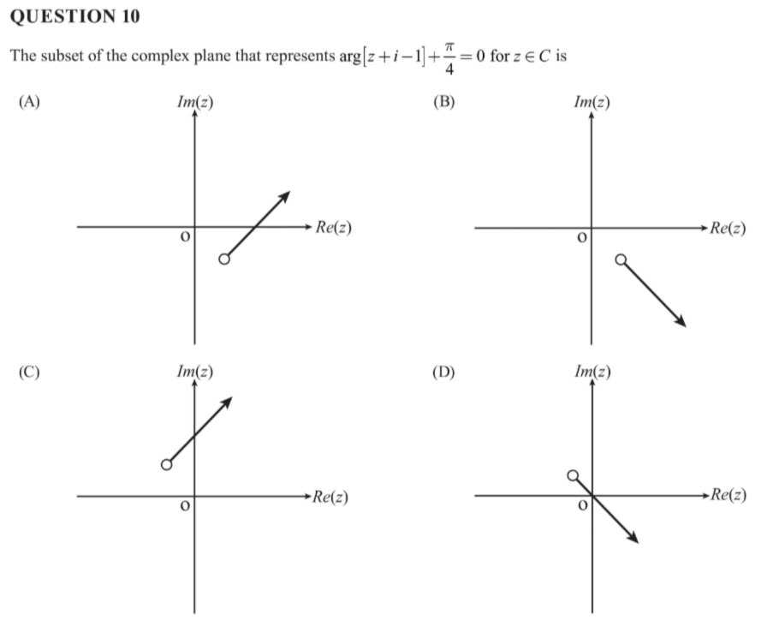
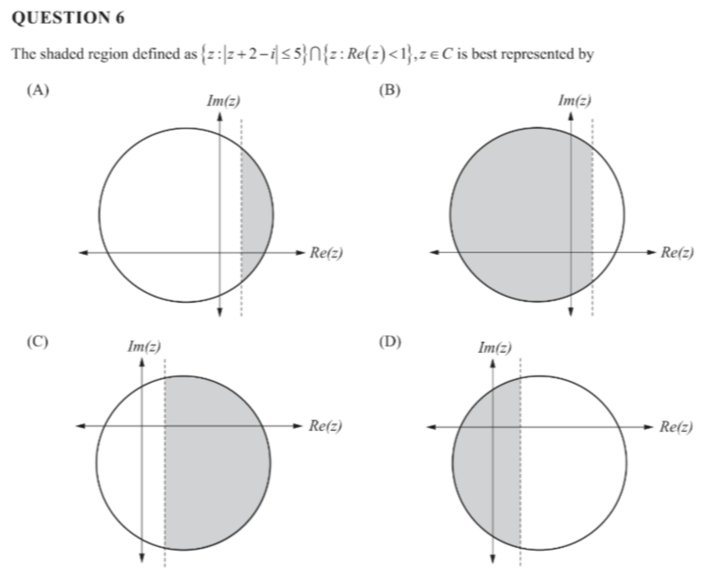
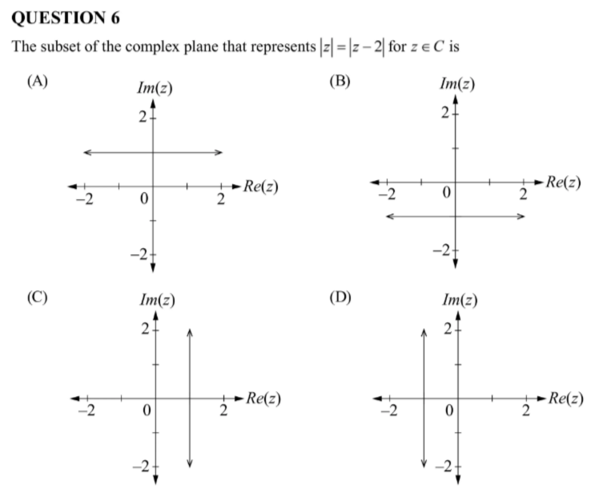
Complex Number (subsets)
2021
2023
2020

Slide 33
Complex Numbers (subsets)
What are you confident with?
What aren’t you confident with?
How can you address that?
How much study time should you devote to this?

Slide 34
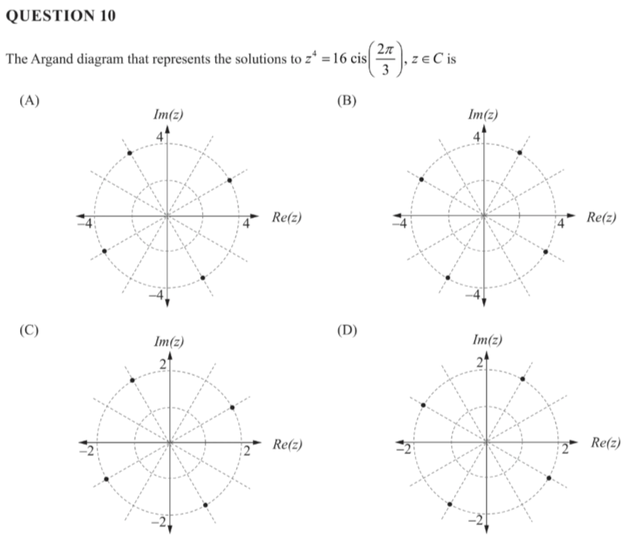
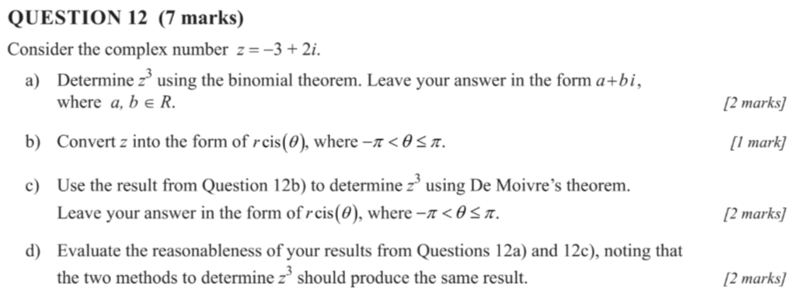
Complex Number De Moivre’s
2023

Slide 35
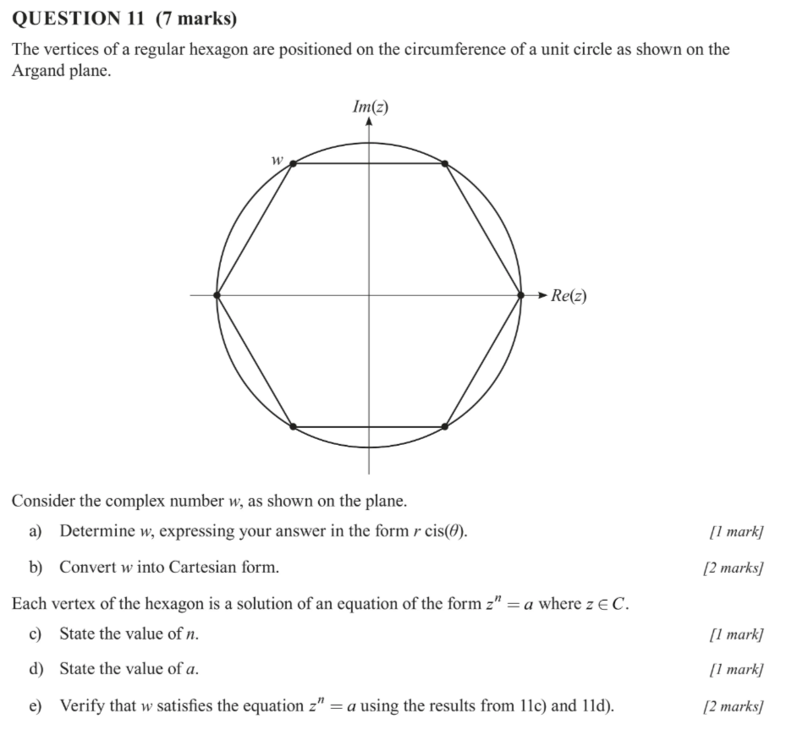
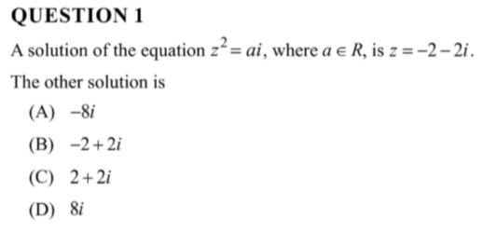
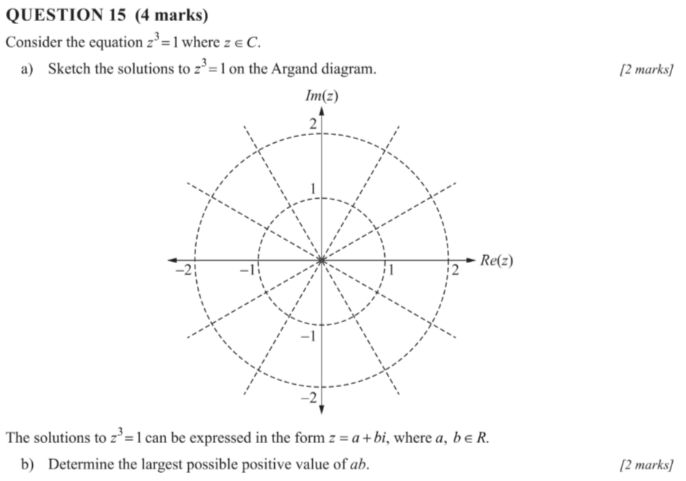
Complex Number De Moivre’s
2020
2022

Slide 36
Complex Numbers De Moivre’s
What are you confident with?
What aren’t you confident with?
How can you address that?
How much study time should you devote to this?

Slide 37
Complex Number The proofs
2023
2021
2022
2020

Slide 38
Complex Numbers The Proofs
What are you confident with?
What aren’t you confident with?
How can you address that?
How much study time should you devote to this?

Slide 39
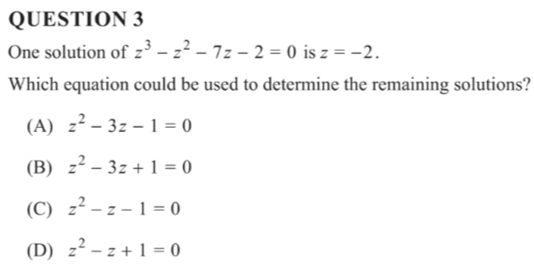
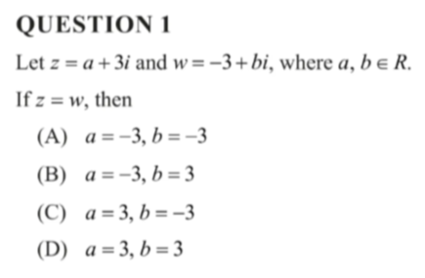
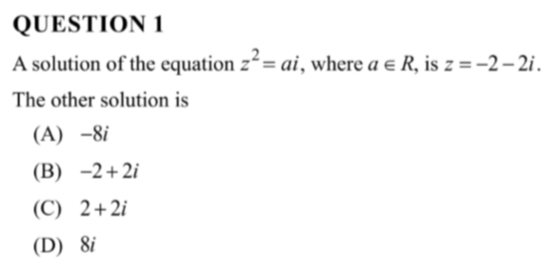
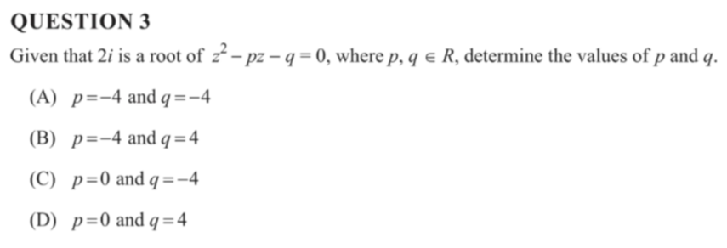
Complex Numbers (the simple stuff)
2022
2023

Slide 40
Complex Numbers (the simple stuff)
2021
2020

Slide 41
Complex Numbers (the simple stuff)
What are you confident with?
What aren’t you confident with?
How can you address that?
How much study time should you devote to this?

Slide 42
Exponential distributions
2022
2023
2020
2021

Slide 43
Complex Numbers (the simple stuff)
What are you confident with?
What aren’t you confident with?
How can you address that?
How much study time should you devote to this?

Slide 44
Integration Techniques
2022
2023

Slide 45
Integration Techniques
2020
2021

Slide 46
Integration Techniques
What are you confident with?
What aren’t you confident with?
How can you address that?
How much study time should you devote to this?

Slide 47
Simpson’s rule
2023
2022
2021

Slide 48
Simpson’s Rule
What are you confident with?
What aren’t you confident with?
How can you address that?
How much study time should you devote to this?

Slide 49
Areas and Revolutions
2023
2022

Slide 50
Areas and Revolutions
2020
2021

Slide 51
Areas and Revolutions
What are you confident with?
What aren’t you confident with?
How can you address that?
How much study time should you devote to this?

Slide 52
Solving Differential equations
2023
2022

Slide 53
Solving Differential equations
2021
2020

Slide 54
Solving Differential Equations
What are you confident with?
What aren’t you confident with?
How can you address that?
How much study time should you devote to this?

Slide 55
Implicit differentiation
2023
2020
2022

Slide 56
Implicit Differentiation
What are you confident with?
What aren’t you confident with?
How can you address that?
How much study time should you devote to this?

Slide 57
Slope Fields
2021
2022
2020

Slide 58
Slope Fields
What are you confident with?
What aren’t you confident with?
How can you address that?
How much study time should you devote to this?

Slide 59
Related Rates
2023
2021

Slide 60
Related Rates
What are you confident with?
What aren’t you confident with?
How can you address that?
How much study time should you devote to this?

Slide 61
Forces and Momentum
2023
$$p=mv$$
$$f=ma$$

Slide 62
Forces and Momentum
2022

Slide 63
Forces and Momentum
2021
2020

Slide 64
Forces and Momentum
What are you confident with?
What aren’t you confident with?
How can you address that?
How much study time should you devote to this?

Slide 65
Acceleration
2020
2023

Slide 66
Acceleration
What are you confident with?
What aren’t you confident with?
How can you address that?
How much study time should you devote to this?

Slide 67
Stats general knowledge
2023

Slide 68
Stats general knowledge
2022
2021

Slide 69
Stats general knowledge
2021

Slide 70
Stats general knowledge
2020

Slide 71
Stats General Knowledge
What are you confident with?
What aren’t you confident with?
How can you address that?
How much study time should you devote to this?

Slide 72
Confidence intervals
2023

Slide 73
Confidence intervals
2022

Slide 74
Confidence intervals
2021

Slide 75
Confidence intervals
2020

Slide 76
Confidence Intervals
What are you confident with?
What aren’t you confident with?
How can you address that?
How much study time should you devote to this?

Slide 77
Sample Means
2023

Slide 78
Sample Means
2022

Slide 79
Sample Means
2021

Slide 80
Sample Means
2020

Slide 81
Sample Means
What are you confident with?
What aren’t you confident with?
How can you address that?
How much study time should you devote to this?

